Slide 1

STAKEHOLDER PLANNING AND ANALYSIS
Fadele-Oluwafemi Iyanu David
13th May 2024

Slide 2



Who is a STAKEHOLDER?
A stakeholder is an individual, group, or organization that has a vested interest in the outcome of a project, initiative, or organization.
They can be internal or external to the project or organization and can include employees, customers, suppliers, regulators, shareholders, and more.
Importance: Understanding the various stakeholders and their interests is crucial for effective project management and decision-making.

Slide 3

Who is a STAKEHOLDER?
Stakeholder planning and analysis is a crucial aspect of business analysis that focuses on identifying and understanding the various stakeholders involved in a project, initiative, or organization.
The process involves assessing the interests, concerns, and influence of different stakeholders to effectively manage relationships and drive successful outcomes.

Slide 4

Understanding Stakeholders
This step is foundational and crucial to the entire process as it involves gaining a comprehensive understanding of the stakeholders involved, their interests, concerns, and influence.
Understanding stakeholders is crucial as they can influence, be affected by, or have a significant impact on the success of a business initiative. Their needs, expectations, and concerns must be considered throughout the analysis process.

Slide 5

Stakeholder Identification
Identifying all the stakeholders involved in the project or organization is the initial step in stakeholder planning and analysis. It sets the stage for further analysis and engagement strategies.
This includes internal stakeholders such as employees, managers, and shareholders, as well as external stakeholders such as customers, suppliers, government agencies, and the local community.

Slide 6

Techniques
Utilise various methods such as stakeholder interviews, surveys, workshops, and document analysis to identify stakeholders.
Criteria: Consider factors such as their roles, responsibilities, interests, influence, and potential impact on the project or organization.

Slide 7

Stakeholder Analysis:
Stakeholder analysis involves understanding the needs, expectations, and attitudes of each stakeholder group. It provides a deeper understanding of the stakeholder landscape.
This can be done through interviews, surveys, focus groups, or by analyzing existing data and feedback.
The analysis aims to identify stakeholders' goals, interests, and potential risks or conflicts that may arise during the project's lifecycle.

Slide 8
Objectives:
Analyse stakeholders: to understand their attitudes, perspectives, requirements, and preferences regarding the project or initiative.
Tools: Employ tools like stakeholder matrices, power/interest grids, and stakeholder registers to categorise stakeholders based on their level of influence, interest, and impact.

Slide 9
Prioritize Stakeholders:
Once stakeholders are identified, it's important to prioritize them based on their level of influence, impact, and importance.
Stakeholders can be categorized into primary, secondary, or tertiary groups depending on their degree of involvement and dependency on the project's outcomes.
This helps in allocating resources and attention effectively.
Factors for Prioritization: Consider stakeholders' level of influence, impact, urgency of needs, alignment with project goals, and level of dependency on the project's outcomes.

Slide 10

Stakeholder Engagement Strategy:
Strategy Development: Develop strategies for effectively engaging and managing relationships with stakeholders throughout the project lifecycle.
Communication Plan: Define communication channels, frequency, and content to ensure stakeholders are informed, involved, and aligned with project objectives.

Slide 11
Managing Stakeholder Relationships/Mitigating Stakeholder Risks:
Risk Assessment: Identify potential risks associated with stakeholders, such as resistance, conflicting interests, or lack of support.
Risk Mitigation Strategies: Develop strategies to address and mitigate stakeholder risks, which may include proactive communication, addressing concerns, involving influential stakeholders, and managing conflicts.
Communication: Establish clear and open lines of communication to foster trust, transparency, and collaboration among stakeholders.
Conflict Resolution: Address conflicts, disagreements, or competing interests among stakeholders in a constructive and timely manner to maintain project momentum and alignment.
Continuous Stakeholder Engagement: Implementing feedback mechanisms and adapting project strategies based on stakeholder feedback ensures that their needs and expectations are met, enhancing stakeholder satisfaction and project success.

Slide 12
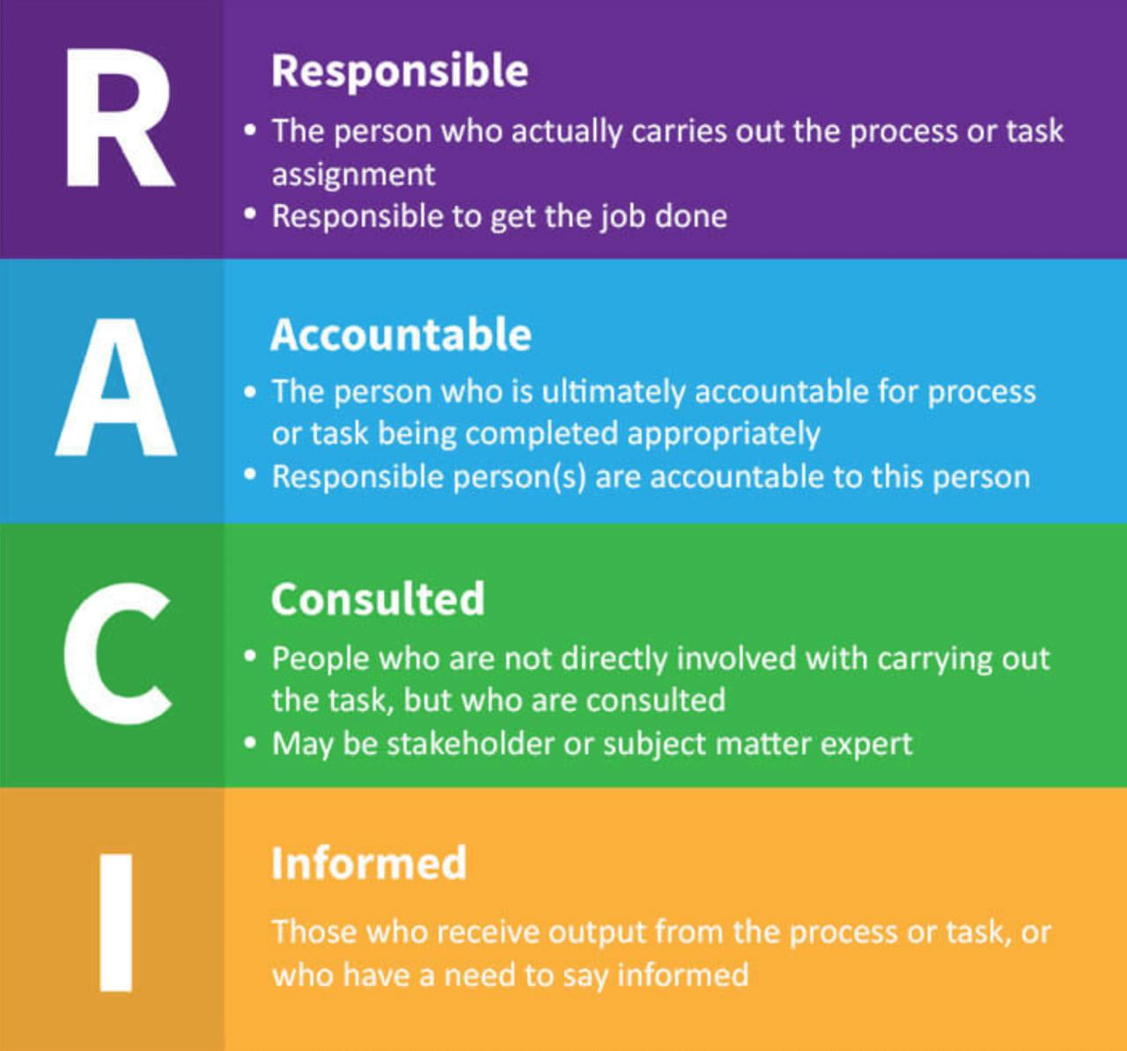
Understanding the RACI Metrics:
Definition:
RACI is an acronym for responsible, accountable, consulted, and informed.
It is a matrix used to define and clarify the roles and responsibilities of stakeholders in a project or process.
Roles in RACI:

Slide 13
Feedback Mechanisms:
Implement mechanisms for gathering feedback from stakeholders at various stages of the project to ensure their needs and expectations are being met.
Adaptation: Use stakeholder feedback to adapt project strategies, requirements, and deliverables as needed to enhance stakeholder satisfaction and project success.

Slide 14
Requirements Gathering & Analysis:
Gathering and analyzing requirements involves understanding the needs, expectations, and objectives of stakeholders to define project scope and deliverables.
Techniques: Use techniques such as interviews, workshops, surveys, and document analysis to collect requirements from stakeholders.
Analysis: Analyze gathered requirements to identify commonalities, conflicts, and prioritize them based on stakeholder needs and project goals.

Slide 15

Conclusion:
Stakeholder planning and analysis are critical components of the business analysis process, enabling organizations to identify, understand, and effectively engage with stakeholders to achieve project objectives and ensure stakeholder satisfaction.
By systematically planning and analyzing stakeholders, business analysts can mitigate risks, address challenges, and maximize opportunities for success.

Slide 16
Thank you

